Slide 1
Capstone Project - Car accident severity
Applied Data Science Capstone

Slide 2
INTRODUCTION
Traffic accidents are...
Cause of 1.35 million deaths globally in 2016.
Main cause of death among those aged 15–29 years. Predicted to become the 7th leading cause of death by 2030.
Predicting the accident severity in advance could be used to send the exact required staff and equipment to the place of the accident, thus saving a significant amount of lives each year.
Road safety should be a prior interest for governments, local authorities and private com- panies investing in technologies that can help reduce accidents and improve overall driver safety

Slide 3
DATA
All the recorded accidents in France from 2005 to 2016, both years included. Initial dataset from the Kaggle, here.
In total 49 features, 839,985 rows in the Kaggle dataset Redundant and not relevant features were dropped
29 features pre-selected
On the data cleaning missing values and outliers were replaced.

Slide 4

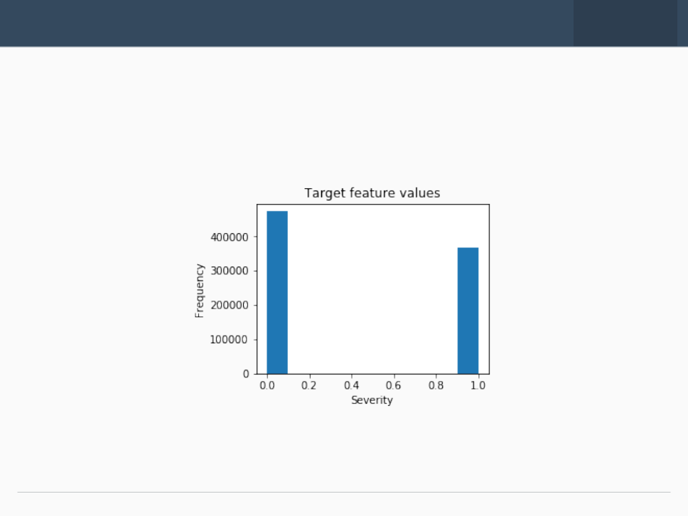



EDA – TARGET
The target feature a binary classifier, describing the accident severity. 0: low severity. 1: high severity, from hospitalized wounded injuries to death.
It is a balanced labeled dataset with more cases of lower severity.

Slide 5
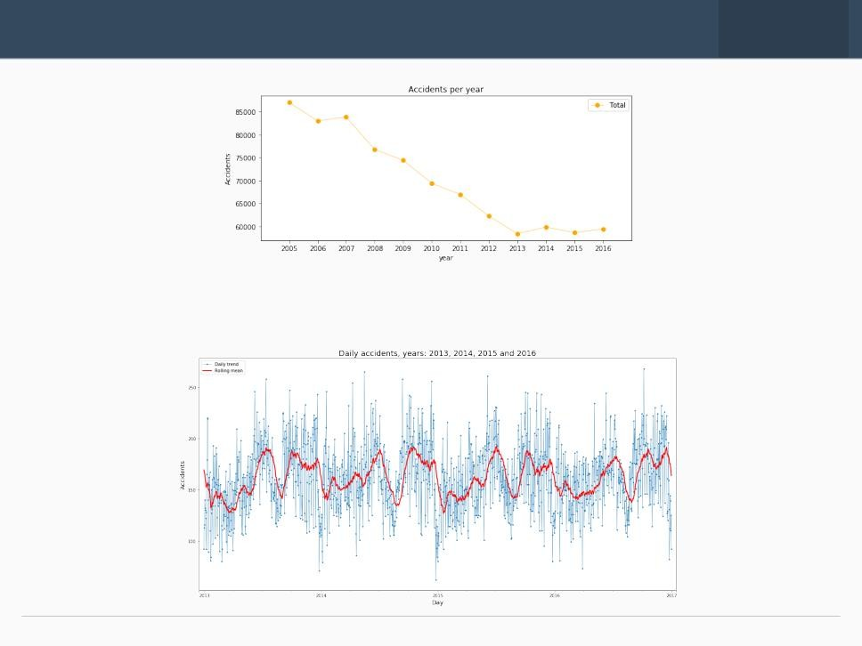
The number of traffic accidents decreased over the years from 2005 to 2013, after which the trend became stable
EDA – SEASONALITY

Slide 6

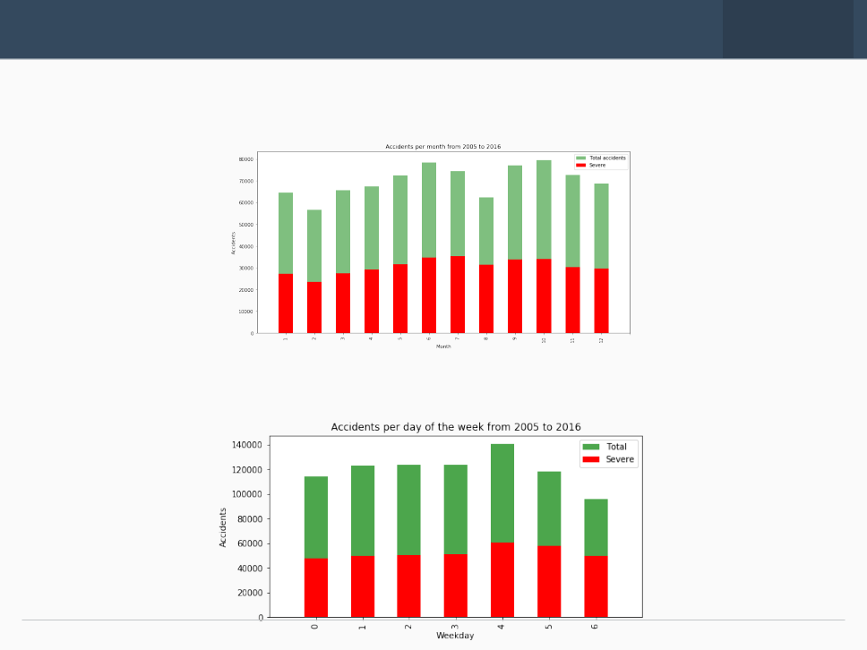
EDA – SEASONLITY
Accidents increase from March to June and then again in September, decreasing at the end of the year.
Steady trend during the week. More accidents on Friday and less on Sunday

Slide 7
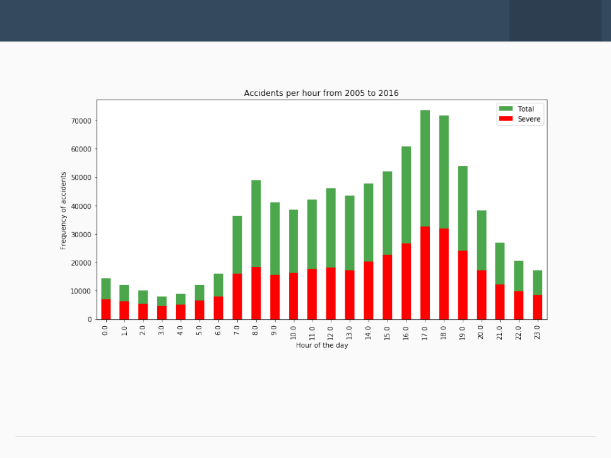
EDA- SEASONLITY
Spikes:
8am: people go to work 5-6pm: people return home.

Slide 8
Random Forest: 10 decision trees maximum depth of 12 features Logistic Regression c=0.001 K-Nearest Neighbor K=16 Supervised Vector Machine Due to computation inefficiency, training size was reduced to 75,000 samples.
Classification Model

Slide 9
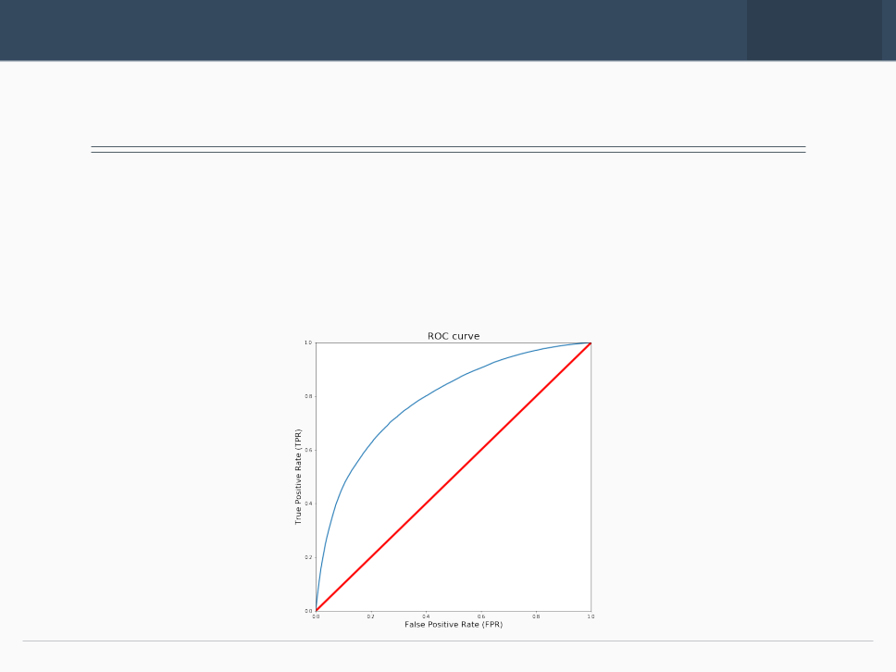
RESULTS
Algorithm | Jaccard | f1-score | Precision | Recall | Time(s)
Random Forest | 0.722 | 0.72 | 0.724 | 0.591 | 6.588
Logistic Regression | 0.661 | 0.65 | 0.667 | 0.456 | 6.530
KNN | 0.664 | 0.66 | 0.652 | 0.506 | 200.58
SVM | 0.659 | 0.65 | 0.630 | 0.528 | 403.92
Without doubt random forest is the best model, it improved accuracy from 0.66-0.72 and the recall from 0.45-0.59

Slide 10
Conclusion
Built useful models to predict the severity of a traffic accident. Accuracy of the models has room for improvement.

